Slide 1

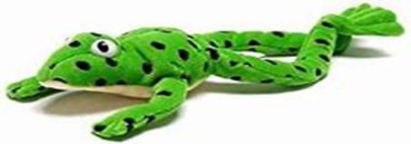
Phonics at
Staplehurst School
Mrs Golding
EYFS Phase Leader

Slide 2
Aims of the session
To have a secure understanding of how we teach phonics at Staplehurst School
To understand the importance of pure sounds
To have a clear understanding of the terminology used when teaching phonics
To see resources used in school to reinforce phonics teaching

Slide 3
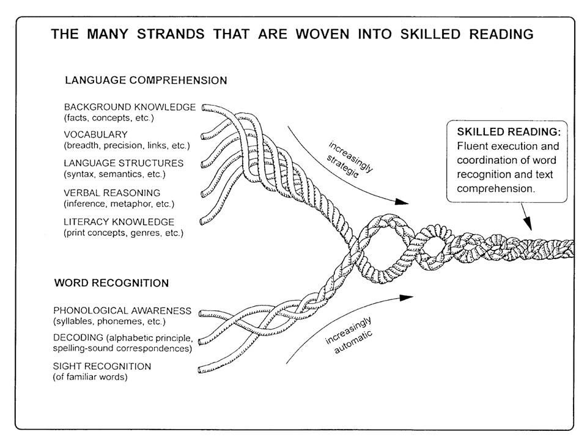
Where does phonics fit into reading?

Slide 4
Phonics Key Vocabulary
Phoneme - the smallest unit of sound
Grapheme - a letter or group of letters that represents a single phoneme in written form
Digraph – 2 letters representing one sound
Trigraph – 3 letters representing one sound
Blending – combine sounds to make a word for reading
Segmenting – separate a word into individual words for writing

Slide 5
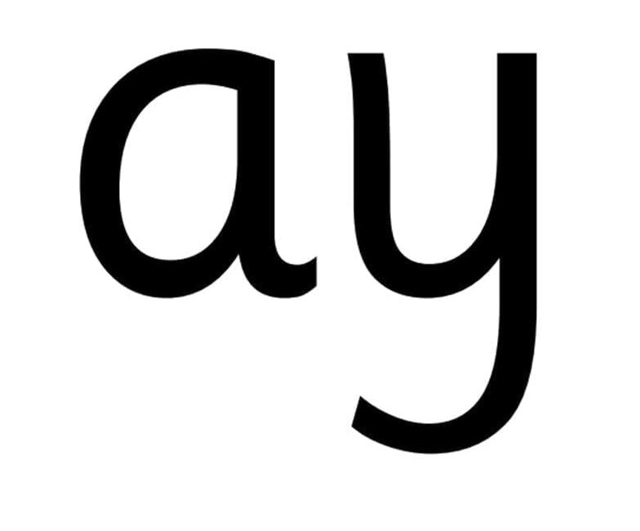
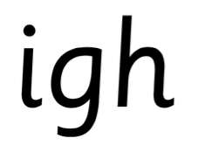
What is Read Write Inc?
Systematic synthetic phonics scheme – validated by DfE
Teaches
  single letter sounds
  Digraphs (2 letters make one sound) – ‘special friends’
  Trigraphs (3 letters make one sound) – ‘special friends’
Blend sounds to read c-a-t
Segment sounds for writing
Whole class initially – later moves to groupings
based on assessments.

Slide 6
What is synthetic phonics?
“Synthetic phonics offers the vast majority of young children the best and most direct route to becoming skilled readers and writers” Sir Jim Rose​
Rose Review of Reading 2006​
Synthetic phonics is the ability to convert a letter or letter group into sounds that are then blended together into a word. ​

Slide 7
Importance of ‘pure sounds’
Pure sounds - 'mmmmmm' not 'muh'
  m-a-t
Must use shortest unit of sound
Stretchy sounds – s, m, l, r, f, v, n, z
Bouncy sounds – t, d, p, g, o, u, c, y, w, b, j,
Refer to sound not letter name - 'a' not 'A (ay)'
  Supports reading and writing

Slide 8
Speed sound pronunciation guide
How to help your child learn the Read Write Inc. phonics sounds

Slide 9
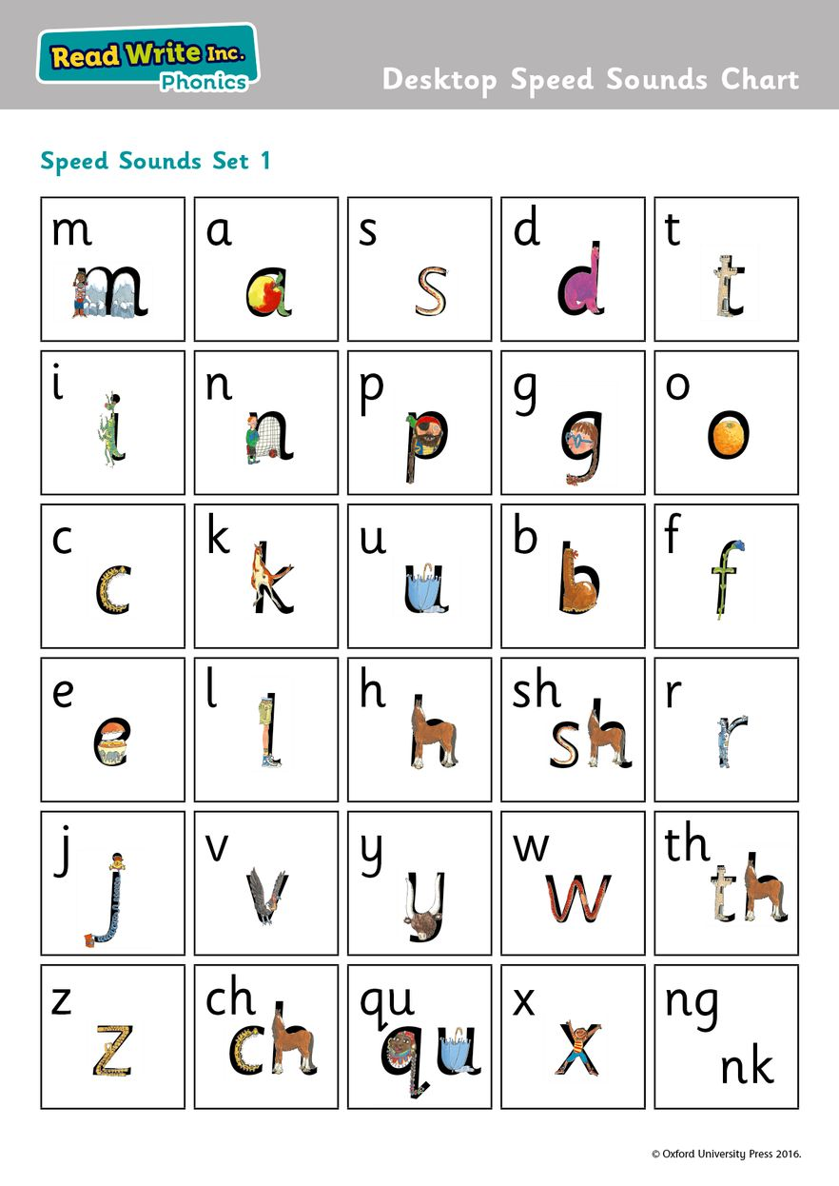
RWI set 1 sounds

Slide 10
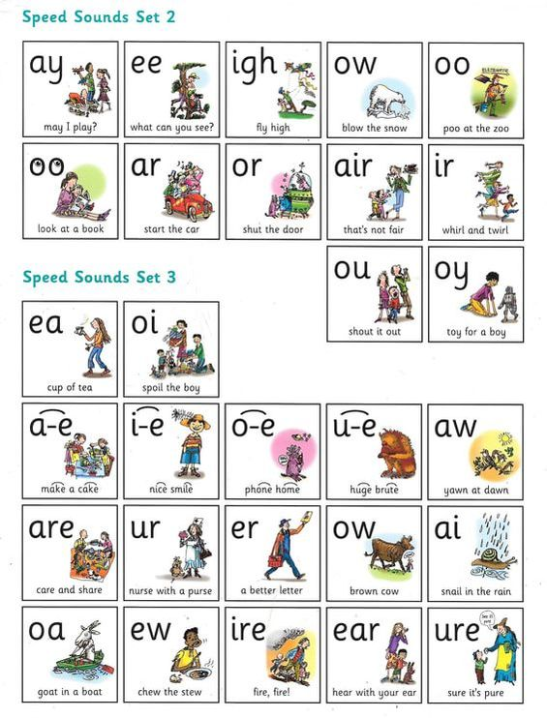
RWI set 2 and 3 sounds

Slide 11
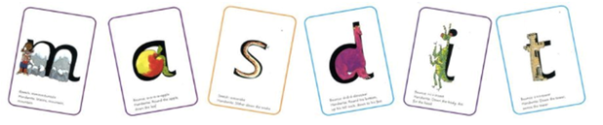
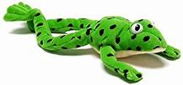
Set 1 lesson template
Picture cards
Introduce sound – link with image e.g. ‘a’ → apple
Recap sounds learnt – add today’s sound to pack
‘Fred talk’ – say the sounds
Green words
3 step process for word reading
  Look for ‘special friends’
  Fred talk the sounds
  Read the word – blend the sounds together

Slide 12
Meet Fred
Fred helps children learn to read
Fred can only say sounds in words – he would say c-a-t, not cat
We call this Fred talk

Slide 13

‘Fred fingers’ for spelling words
Fred also helps children learn to spell simple words
We pinch the sounds on our Fred fingers
  We count the sounds and say the sounds we hear
Write the sounds you can hear in the word
  Initial sound
  Middle sound
  Final sounds

Slide 14
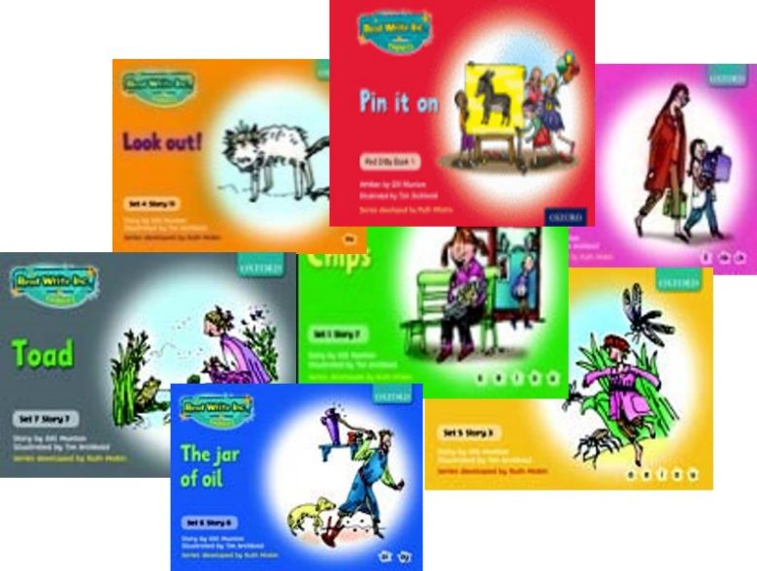
RWI Books – used in phonics lessons
Termly assessment shows which level RWI book is appropriate
Read in lessons time x 3
Linked with sounds already
learnt
Builds fluency and automaticity

Slide 15
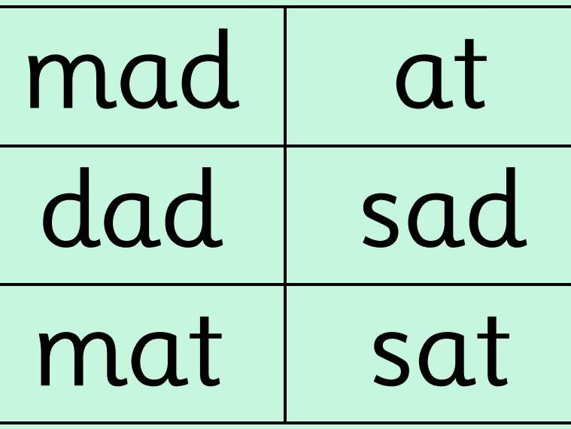
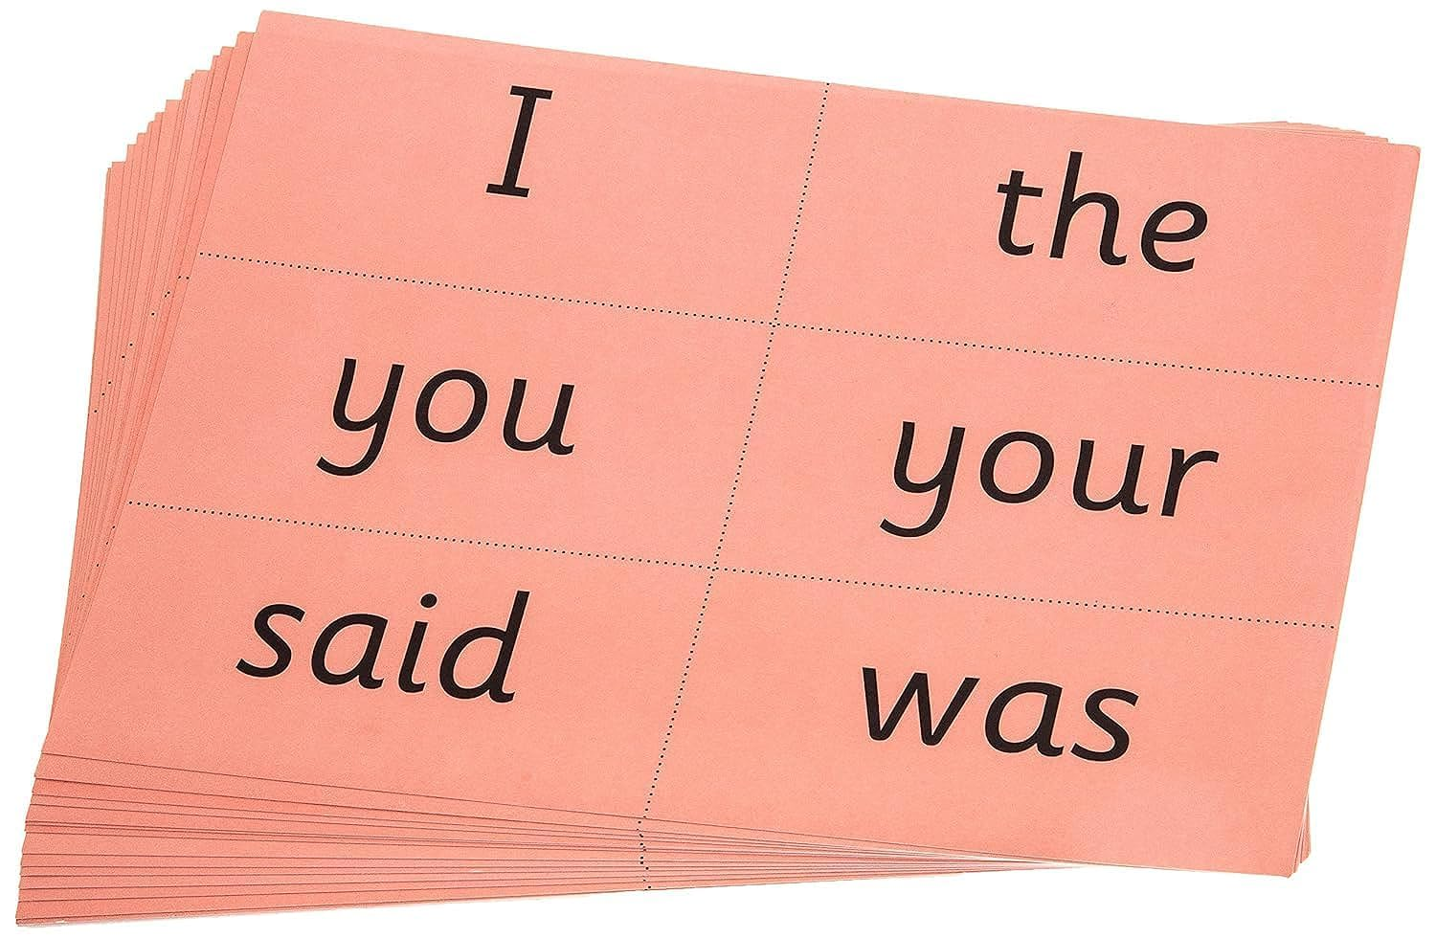
Green words
Red Words

Slide 16
Year 1 Phonics Screening Check
Term 6 of Year 1
Ensure all children reach a good standard of phonic knowledge for decoding
Children read 40 words
  Real words
  ‘alien’ words – not real
Pass mark 31/40

Slide 17
Ways to help your child
Recap sounds learnt
  Within homework folder weekly – remember to use pure sounds
Regularly reading home reading book
  Carefully matched to their phonic knowledge
  3 step process – Special friends, Fred talk, Read the word
  Read it more than once – builds fluency and word recognition
Share books together
  Library book weekly to share
  Books from home
  Develop love of reading through personal book choice
  Exposes them to wider vocabulary

Slide 18
Home reading
Reading Log – checked on Tuesdays and Fridays
  For recording reading only
  Other messages to be sent via year group emails or to office if urgent
    Initially wordless books– tell the story orally through the pictures

Slide 19
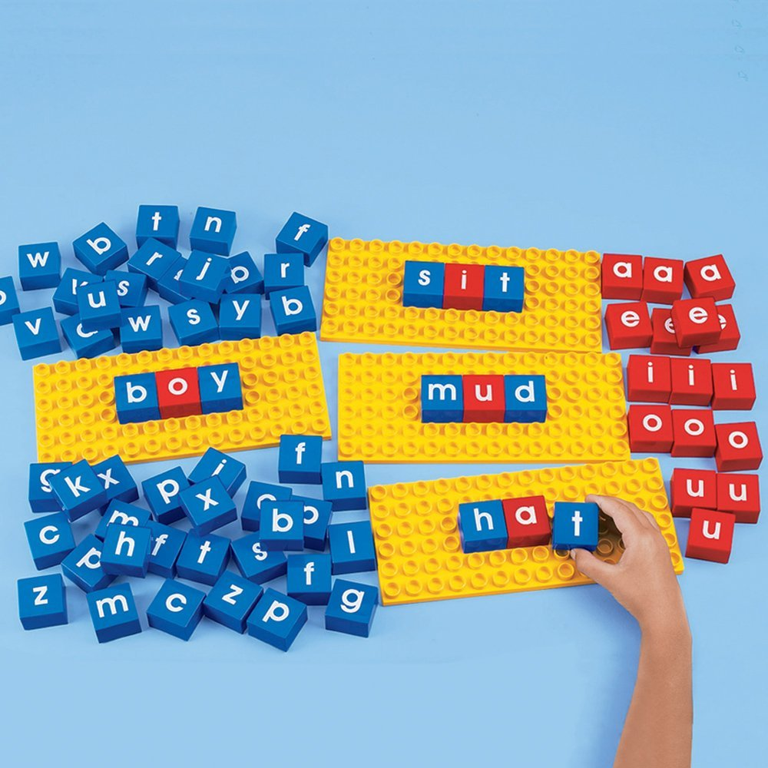
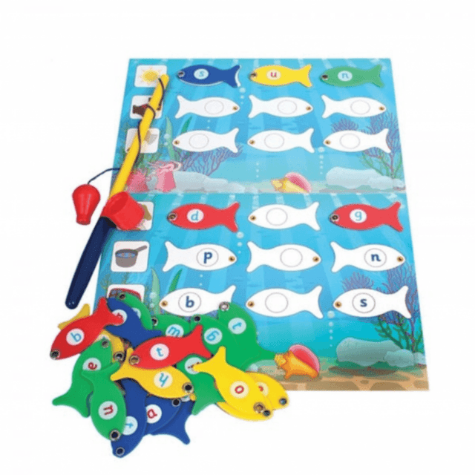
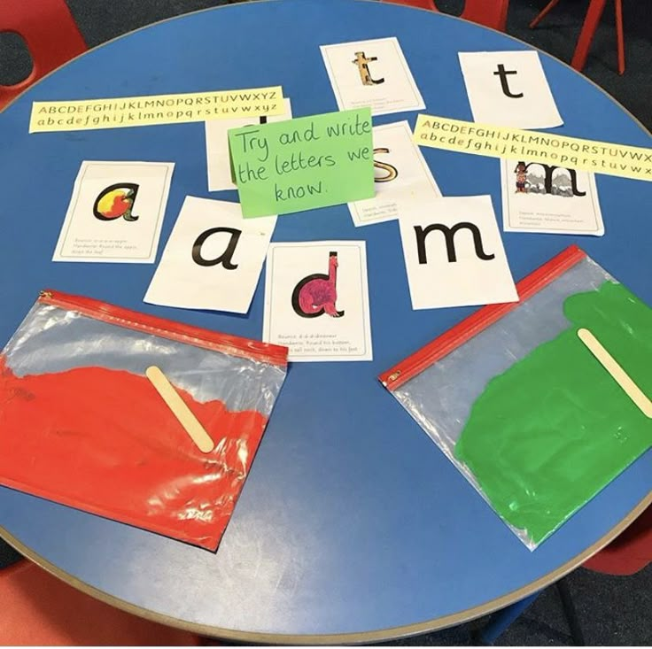
Explore some phonics resources
These are some of the activities we use within Child-initiated learning to reinforce phonics teaching.

