Slide 1

Welcome to EYFS 2026-27

Slide 2
The Senior Leadership Team
Mrs Wall – Headteacher
Mr Tate – Deputy Head
Mrs Farrell – Assistant Head
Mrs Johnson – Assistant Head

Slide 3
EYFS Teaching Team
Mrs Golding – EYG, Benjamin Class,
EYFS Phase Leader
Miss Fraser – EYF Farah Class
Mrs Batten Teaching Assistant

Slide 4
EYFS vision
We believe every child deserves a high quality, inclusive early education, which provides the foundations for future learning. We want our children to feel happy, safe and secure to enable them to become independent, resilient learners.

Slide 5
EYFS Curriculum
Our curriculum follows the EYFS Statutory guidance​
We use a combination of child initiated and teacher directed learning.​
We teach phonics through the ‘ReadWrite inc’ phonics scheme.​
Maths is taught using White Rose
In EYFS we teach the foundational knowledge necessary for the National Curriculum subjects.

Slide 6
Important dates
Thursday 3rd September – drop-in sessions to familiarise children with their new classrooms
Friday 4th September - children begin part-time 9.00 – 12.00
Monday 7th – Friday 11th September – part-time 8.35-12.00
Meet the teacher sessions during the first 2 weeks – please sign up for an appointment if you have not already done so.
Week beginning Monday 14th September - children stay for lunch – either school lunch or packed lunch. Drop-off between 8.35 and 8.50, finish at 1.30
During this second week, the children will stay for 1 full day, Tuesday or Thursday
Week beginning Monday 21st September - children are full time, 8.35 - 3.15

Slide 7
Timings once the children are full time
Drop off between 8.35-8.50. Gates close at 8.50
Once the children are settled into school, they should be dropped at the wooden gate and walk around to their classroom.
The school day finishes at 3.15
Pick up is from the classroom doors.

Slide 8
What will my child need each day?
Book bag – please do not send ruck sacks as we do not have the space to store them during the day
Named water bottle – water only, no juice. Bottles are refilled as needed throughout the day
A named coat - we go outside as often as possible
PE bag – these are left in school and only taken home when needed for example washing
Spare underwear and clothes in case of accidents
Reading log book and reading book – provided by school

Slide 9
Home-school communication
Face to face at school pick up
Year group email – eyfg@staplehurst.kent.sch.uk
School office for urgent messages during the school day (01580 891765)
Absences should be reported to the school office
Parents evenings twice yearly
Phonics information and drop-in sessions
Parents into read sessions
Weekly newsletter

Slide 10
Communication
Key information
The school office is open from 8:30am to 4:00pm during term time.
Key information about the school, including term dates, curriculum details, policies, events, and announcements, is available on our website.
Our weekly newsletter is shared via SCOPAY and published on the school website.
Complaints Procedure
If you have a concern, we encourage you to speak first with your child’s class teacher. If the issue is not resolved, please contact the phase leader or deputy headteacher to arrange a meeting.
Should the matter remain unresolved, you may contact the headteacher. If you are still dissatisfied, the school’s Complaints Policy, available on our website, outlines the formal procedure to follow.

Slide 11
School uniform and PE Kit expectations
In September pupils needs to return in winter uniform.
One pair of stud earrings only. Please remove on PE day
School shoes not trainers are to be worn
Bows should be navy or school yellow and no bigger than the palm of your child’s hand. Hair below shoulders needs to be tied back.
Blue P.E. t-shirt, blue or black shorts, plimsolls or trainers. No jewellery should be worn.
If your child is unable to take part in P.E, please send an email to explain why.
Ensure items of clothing, water bottles, coats, hats, bags etc are named

Slide 12
Expectations at Staplehurst
At Staplehurst School, we demonstrate…
Positivity
  A positive attitude to school and learning; Being kind and supportive to each other.
Respect
  Showing respect to adults and each other; Being polite and well behaved in the classroom and around school.
Independence
  Being independent and motivated with learning.
Determination
  Being determined and resilient learners; 100% effort at all times.
Excellence
  Setting a good example to the rest of the school; Demonstrating excellence in behaviour, attitude and learning.

Slide 13
Behaviour Expectations
As per our behaviour policy, we band behaviour accordingly. Whilst our approach is always restorative and preemptive, when we do encounter behaviour that doesn’t meet the high-expectations we have, the following measures/procedures are considered:
A class behaviour chart is used – sunshine and ‘wow’, raincloud and ‘oh dear’. Each day is a new day.
Age-appropriate sanctions are used – calm down time
Behaviour reported to parents at the end of the day.
All unwanted behaviour is be taken seriously. Despite children’s developmental stages, ‘wanted’ behaviour needs to be reinforced.

Slide 14
Rewards at Staplehurst
Verbal praise
PRIDE Points & PRIDE Rewards
  Reward equipment at playtime
  Non-uniform days – house PRIDE winners
Certificates in Celebration Assembly
Prizes e.g. Books for 30 reads

Slide 15
Home Learning
Children will be given a reading log to record their home reading. Please read with your child daily.
Reading logs should be sent into school every day.
Phonics cards sent home to practise
Reading logs will be checked and books changed twice weekly – Tuesdays and Fridays.
The children will bring home a library book for you to share, weekly.
Home learning is sent home on Friday and should be returned by the following Friday.

Slide 16
Attendance
It is essential to be in as much as possible to maximise learning and give children the best chances at success and integration.
Excellent attendance 100%​
Good attendance Above 97%​
Satisfactory attendance at 97%​
Unsatisfactory attendance below 97%​
Please inform school office if your child is going to be absent​
Staplehurst school is committed to the continuous raising of achievement of all our pupils. Regular attendance is critical if our pupils are to be successful and benefit from the opportunities presented to them……Good attendance is fundamental to a successful and fulfilling school experience. (Staplehurst School Attendance policy)​

Slide 17
Punctuality
As well as regular attendance, punctuality is also crucial.​
Learning begins as soon as the children enter the classroom.​
Being 10 minutes late every day equates to 5 days of lost learning over the year.​
Regular attendance and punctuality are important values to establish for beyond education.​

Slide 18
Wrap around care
Breakfast club arrive from 7.30am – 8.00am.​
Cost £3.50​
Book in advance, places limited​
After-school club 2 sessions​
Pre-book through Scopay​
3.15pm - 4.30pm – cost £5.50​
3.15pm – 5.30pm – cost £10

Slide 19
Practical ways to prepare your child for school​
Independent toilet training ​
Practice washing hands independently ​
Practice getting changed independently ​
Clearly label every item of clothing ​
Make sure your child can recognise their own name – personal symbol ​
Spare clothes in their PE bag ​
Encourage your child to drink water if this is not their preferred drink – refrigerate ​
Encourage your child to try different fruit and vegetables – snack provided by school ​
Practice eating with a knife and fork – cutting up food ​
Reinforce that special toys/blankets must stay at home ​

Slide 20
Support for starting school
Useful sites
Starting School – PACEY
Home - Starting Reception
Starting primary school - BBC Parents' Toolkit - BBC Bitesize
top-tips-for-starting-primary-school.pdf

Slide 21
Supporting your child’s language development
Notes:
Starting school is a big step—not just emotionally or physically, but also in how children communicate. Children are expected to follow instructions, share ideas, ask for help and play alongside others. These things all rely on strong speech, language and communication skills

Slide 22

Current challenge
Many children struggle with conversation skills, including taking turns in conversation, following instructions and speaking in full sentences.
School age language means pupils need to understand and use longer, more structured language.
Notes:
We’re noticing more children coming into school struggling with basic communication—things like taking turns in conversation, listening to an adult’s instructions, or speaking in full sentences.
Part of this can be down to modern life—busy families, time pressures, and yes, increased screen time, which reduces face-to-face interaction.

Slide 23
5 Strategies for parents
1. Talk through the day
  Use real-life routines (shopping, getting dressed, bath time) as chances for conversation.
2. Comment, don’t quiz
  Instead of constant questions ("What colour is that?"), try narrating.
Notes:
“Let’s put your socks on before your shoes.”
“We’re going to Tesco. First, we need apples. Then, we’ll look for bread.”
This builds sequencing, vocabulary, and understanding of instructions.
2. “You’re building a tall tower! It might fall if you add more.”
Children hear richer language and feel less pressure.

Slide 24
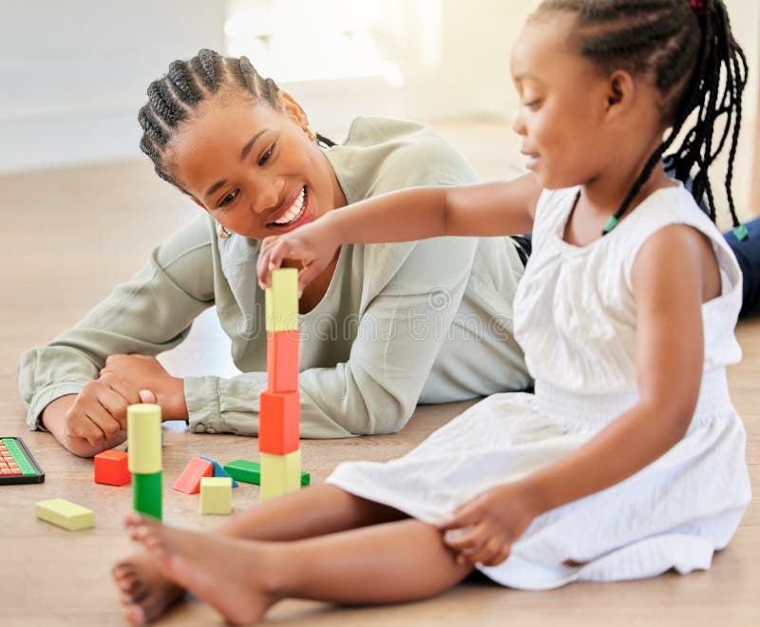
5 Strategies for parents
3. Switch off and tune in
  Encourage “device-free playtimes”
4. Use stories every day
  Read the same book multiple times, talk about the pictures, act it out with toys.
Notes:
3. “Just 15 minutes of playing on the floor with your child every day—with no screens around—can make a huge difference.” Face-to-face interaction helps develop turn-taking and back-and-forth conversation.
4. Repetition builds vocabulary and comprehension. Develop an enjoyment and pleasure in reading.

Slide 25
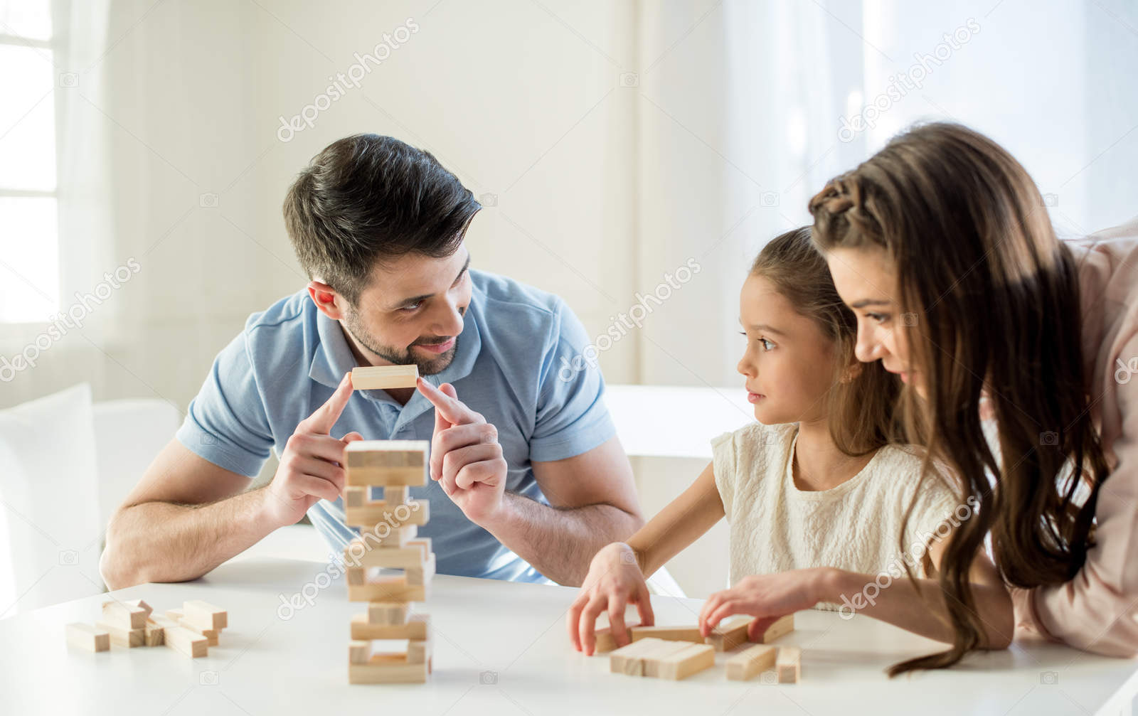
5 Strategies for parents
5. Play turn-taking games
  Simple games like “Simon Says,” “I Spy,” or board games teach listening and speaking in turn.
Notes:
5. These mirror classroom interactions and routines.
You don’t need to be a teacher to build these skills. Talking, listening and playing with your child every day is the best preparation for school. And if you do have any concerns—about speech, attention, or social communication—please don’t wait. We’re here to help.

Slide 26
Pupil Premium
Notes:
The Pupil Premium is an important program that could benefit your child and our school.
The Pupil Premium is a government funding initiative designed to provide extra financial support to schools. This additional funding is aimed at improving the academic outcomes of children from families who may face financial challenges. It helps ensure that every child has the opportunity to succeed, regardless of their background.
The funding allows our school to provide additional educational resources e.g. workshops and events, support staff, and extracurricular activities tailored to your child’s needs, including lunch clubs.
With the Pupil Premium, we can offer more targeted support for pupils such as Speech and Language therapy.
Your child may benefit from subsidised enrichment activities, including school trips, music lessons, and sports clubs.
Every child can benefit. The funding not only benefits individual students by narrowing gaps between disadvantaged students and their peers, but also helps improve the overall learning environment and resources of the school.
Potential for free school meals in KS2, depending on the level of support.
The more families we have signed up, the more support we can offer.

Slide 27
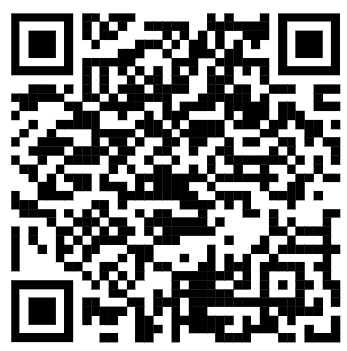
Pupil Premium
Your child may be eligible for the Pupil Premium if you receive, or have received in the last six years, any of the following benefits:
Income Support
Income-Based Jobseeker's Allowance
Income-Related Employment and Support Allowance
Support under Part VI of the Immigration and Asylum Act 1999
The guaranteed element of Pension Credit
Child Tax Credit (provided you’re not also entitled to Working Tax Credit and have an annual gross income of no more than £16,190)
Working Tax Credit run-on (paid for 4 weeks after you stop qualifying for Working Tax Credit)
Universal Credit (provided you have an annual net earned income of no more than £7,400)
Additionally, children of service families, or who are in care or have previously been in care, for any period of time, may also be eligible for Pupil Premium.
Notes:
Applying for the Pupil Premium is straightforward, confidential, and can make a significant impact. If you think your child may be eligible, I urge you to apply as soon as possible. By doing so, you not only support your child’s education but also contribute to the wider school community.
By reaching out, we hope to engage all eligible families and ensure that every child receives the support they deserve. Please do not hesitate to get in touch if you need any assistance or further information.

Slide 28

Welcome to
Staplehurst
School PTA
What you’ll hear today
Who the PTA are
How we raise funds
What those funds provide
How to stay connected
An introduction for parents and carers joining our school community.
Ways to support or join in
Kelly & Nikki
Chair & Secretary
Staplehurst School PTA
1

Slide 29
Who we are — and what we do
The PTA brings families together to make school life even more special.
Who are we?
What do we do?
The core PTA members are parents from across different year groups — working and non-working — who volunteer their time to support the school.
We provide things the school budget does not cover — helping bring fun into learning and making school life extra special.
We do this by running events children love and by raising funds through events, grants, donations and sponsorship.
Our aim: more memorable moments for every child at Staplehurst.
Staplehurst School PTA
2

Slide 30
How we raise funds
A mix of school events, everyday giving and local support keeps the PTA active.
Events
Online shopping & donations
Grants & sponsorship
Discos
Easy Fundraising
Local businesses
Non-school uniform days
Your School Lottery
House builders
Raffles
Name tag commission
Utility companies
Seasonal events
Raffle & gift donations
Supermarkets
Santa shop
Clothing bank
Match funding
Summer Fair
Art projects
Colour run
Every small activity contributes to larger improvements for the children.
Staplehurst School PTA
3

Slide 31
How we spend funds
Money raised is put back into experiences, equipment and everyday school life.
Funded items include:
01
02
03
School environment
Play & movement
Learning & celebration
New flag
Outdoor learning area
Playground artwork
Equipment repairs
Multigym equipment
Christmas crackers
PA system
Musical chimes
Educational workshops
Celebration bookmarks
Activities that make school life extra special
PTA spending is focused on practical, joyful additions that children can see and use.
Staplehurst School PTA
4

Slide 32
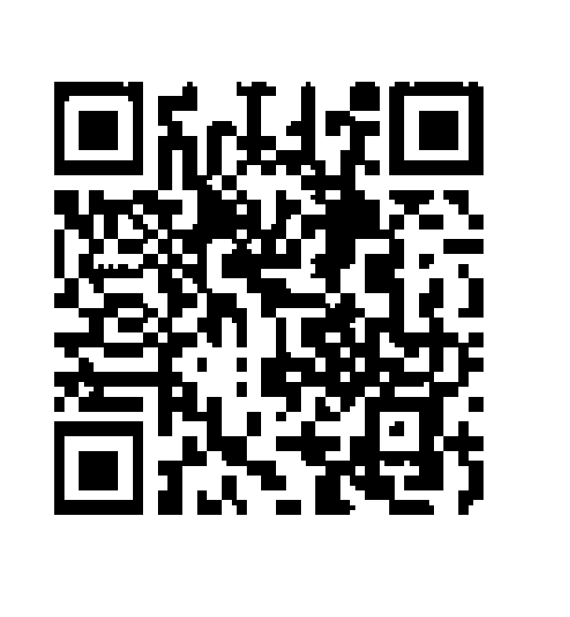
How to find out about us
Look for PTA updates in the places parents already use.
Noticeboards
Facebook
Find information about our events on the noticeboards inside the entrance gates.
Scan the QR code to find us on Facebook and follow updates from the PTA.
Entrance gates
SCAN ME
Tip: event details and volunteer requests are shared regularly.
Staplehurst School PTA
5

Slide 33
Why support or join the PTA?
Six reasons parents and carers get involved.
1
For the children
4
Be connected
Show your child that you value their education. PTA events help improve their school experience.
Know what is happening in school and meet others with the same goal: improving school life.
2
For you
5
It is fun!
Volunteering is rewarding. We plan social events, raise money and enjoy each other’s company.
From planning events to running a stall, we enjoy ourselves in our roles.
3
For the school
6
Keep the PTA going
Help raise funds and have a voice in purchases that support the children.
As parents leave the school, new volunteers keep the committee going. Many hands make light work.
Staplehurst School PTA
6

Slide 34
Six easy ways to help
If you cannot volunteer regularly, there are still simple ways to support the PTA.
1
Easy Fundraising
4
MyNameTags
Sign up and donate as you shop, at no cost to you.
easyfundraising.org.uk/causes/staplehurstpta
Use our school ID at checkout so the PTA receives commission.
mynametags.com/checkout · ID 35506
2
Your School Lottery
5
Stikins labels
£1 tickets: a guaranteed school cash prize and a chance to win the £25,000 weekly jackpot.
yourschoollottery.co.uk/lottery/school/
staplehurst-school-pta
Use our fundraising number when ordering name labels.
stikins.co.uk/name-labels · ID 22274
Direct donation
6
Easy2name labels
3
Use our discount code at checkout and the PTA receives commission.
easy2name.com · FR-STAPLEHURSTPRIMARY-94
Make a regular or one-off payment to support fundraising goals.
Email: Staplehurstschoolpta@gmail.com
Thank you for supporting the children, the school and the wider PTA community.
Staplehurst School PTA
7

